Slide 1

Sentiment Analysis COVID-19
Shanmuka Srinivas
Harsha Magapu
Nivas Manduva

Slide 2
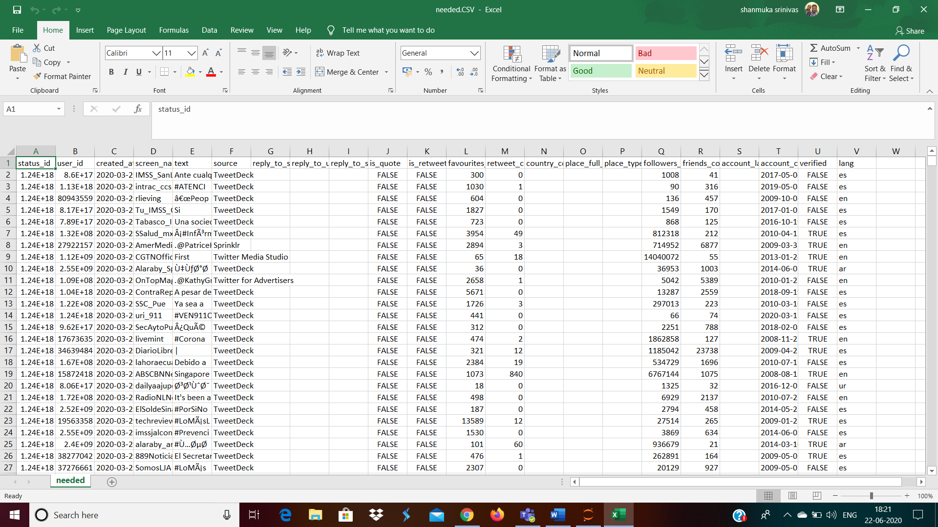

Slide 3
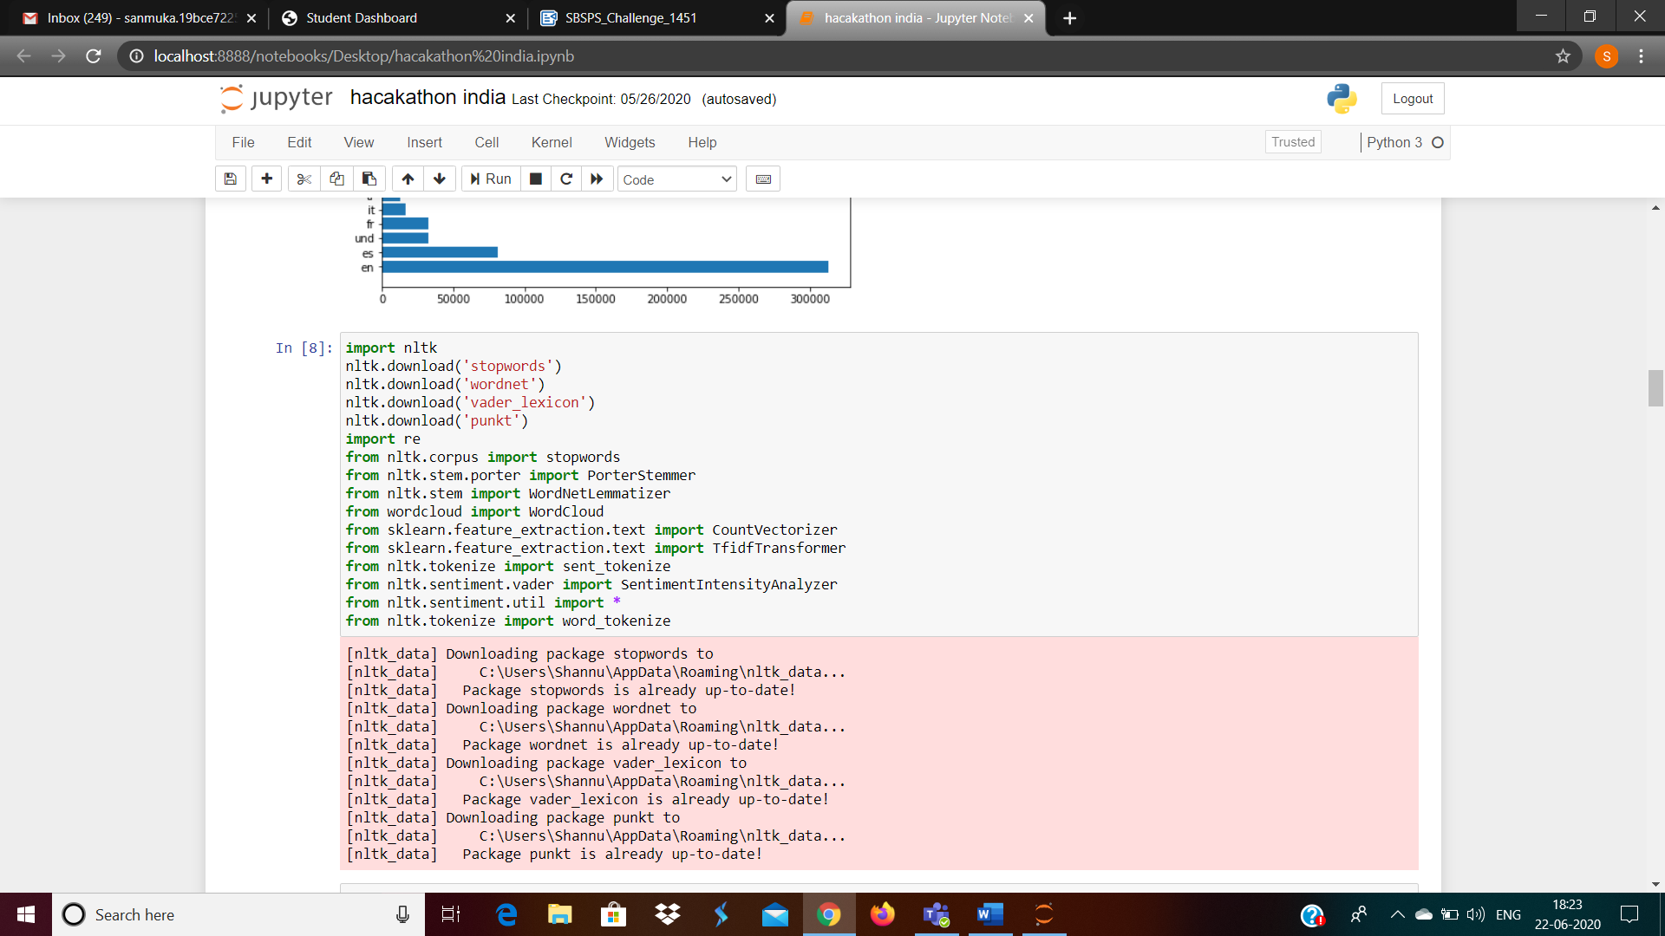

Slide 4
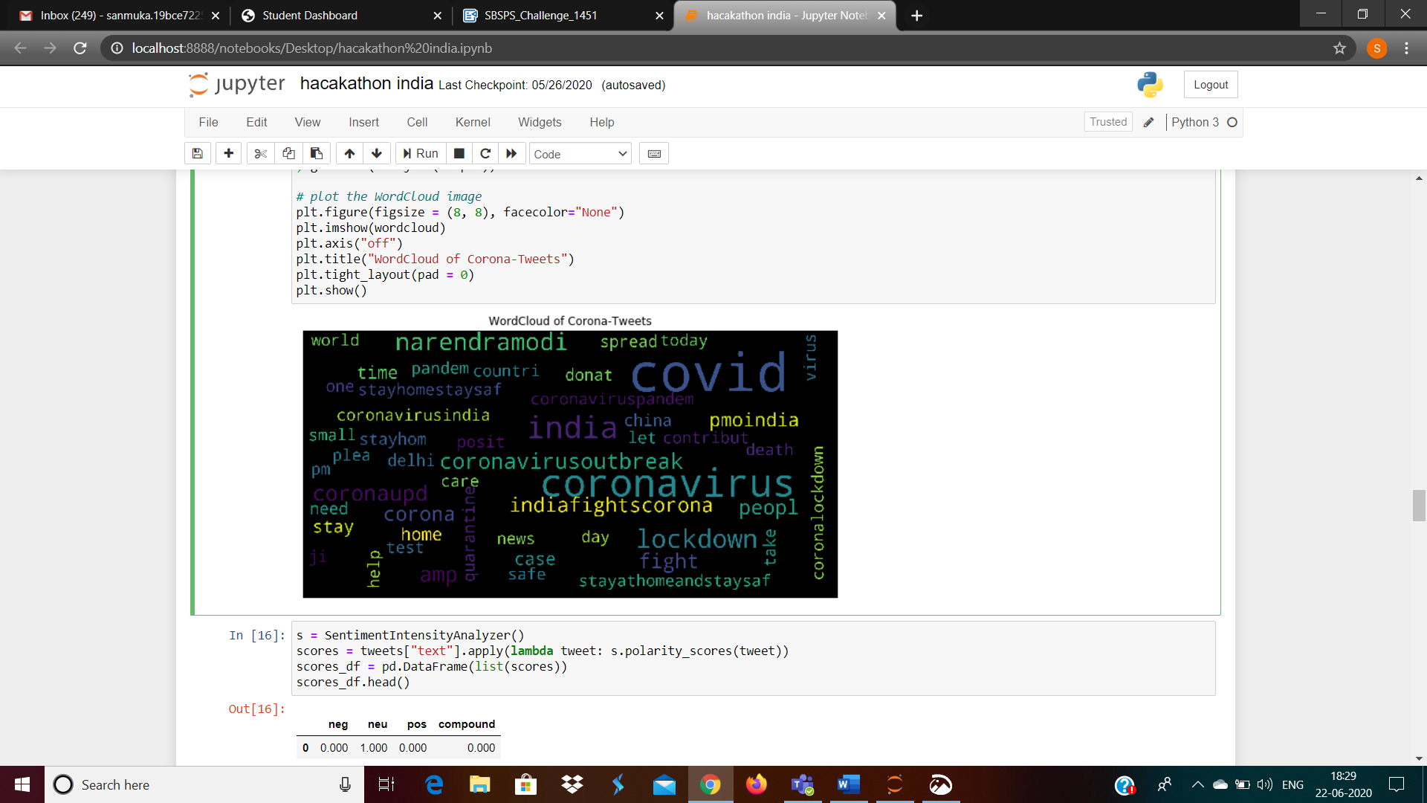

Slide 5
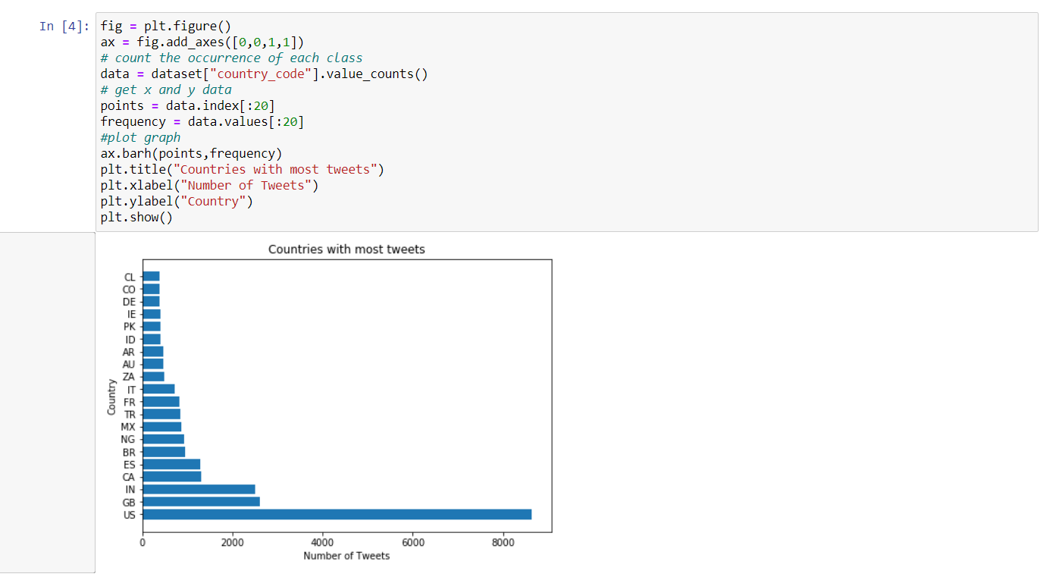

Slide 6
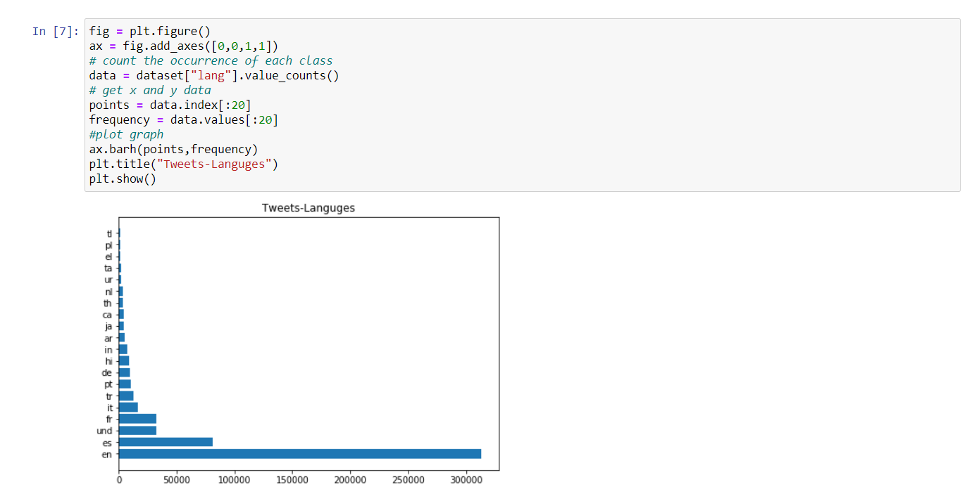

Slide 8
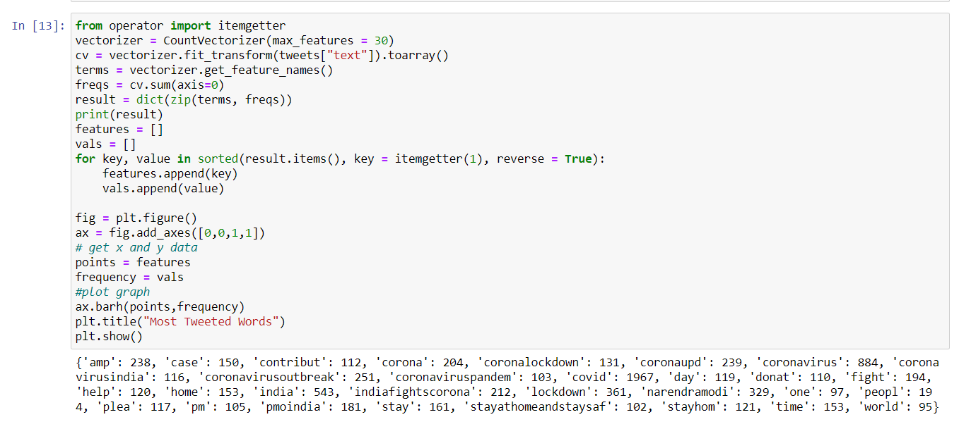

Slide 9
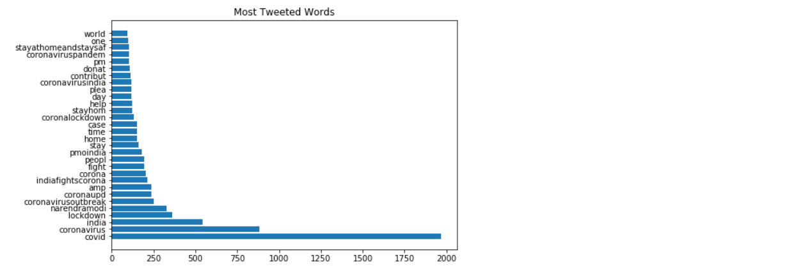

Slide 10
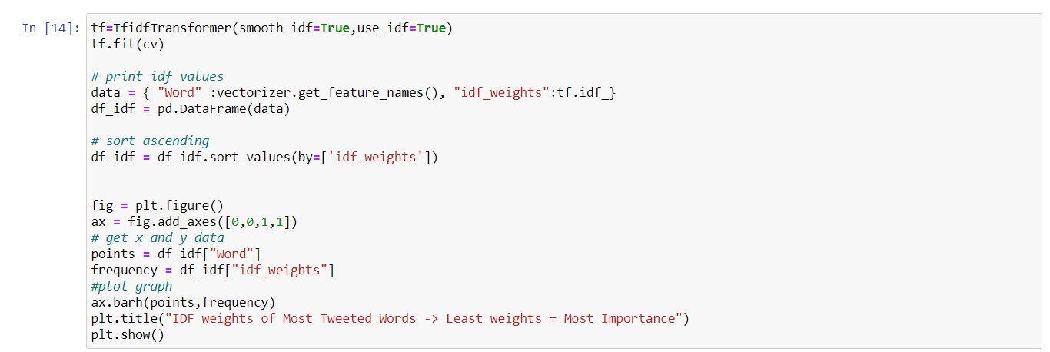

Slide 11
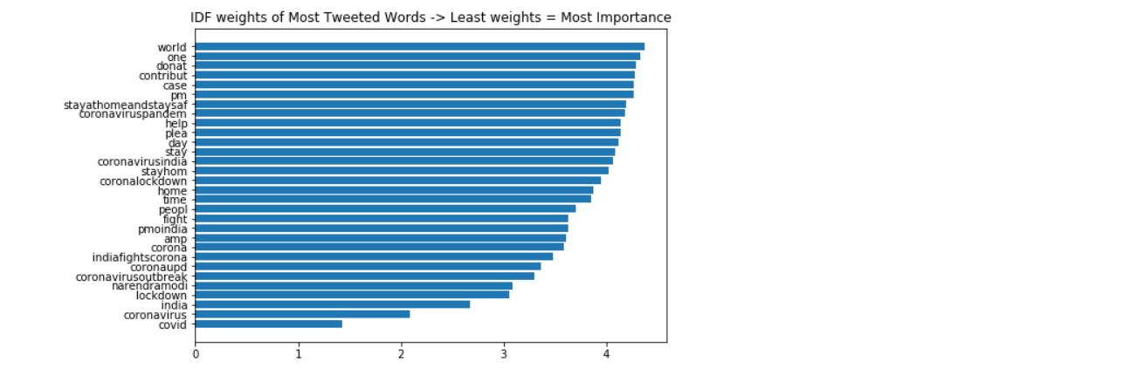

Slide 12
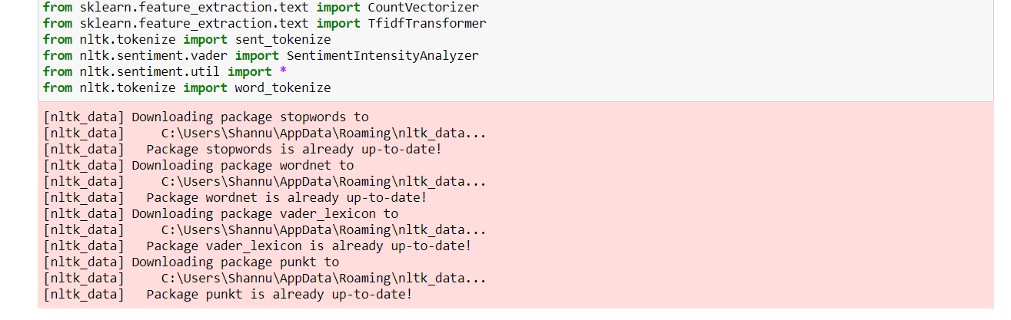

Slide 13
INTRODUCTION TO CHATBOT
*An Internet bot, web robot, robot or simply bot, is a software application that runs automated tasks (scripts) over the Internet. Typically, bots perform tasks that are simple and repetitive, much faster than a person could.
*Allows the chat bot to be trained using data from the NLTKdialog corpus. NLTK comes with a corpus data and utility module that makes it easy to quickly train your bot to communicate. To do so, simply specify the corpus data modules you want to use.
*While developing a chatbot, we first design the capabilities or request the chatbot can handle.
*As I have mentioned earlier, always design the capability classes first, these classes are nothing but the intents to which the chatbot can answer.
*In other words intent is the class of operations or requests which can be handled by the chatbot to give response.

Slide 14
*We made this predefined chatbot with scratch and this is to help users find there ans quickly on our short collected data
*Training the bot with new predefined word
Exporting the data into the bot from the data which is visualized
So data have been saved and collected in the word document and as it is the output of the bot
def chatbot(): print("Hi, I'm Inovatee") chatbot() chat=Chat(self_pairs, reflections) chat.converse()
Print the output
C:\Users\harsh\anaconda3.7\pythonw.exe C:/Users/harsh/PycharmProjects/chatbot/bot.py
Hi, I'm Inovatee
>hi
Hey

Slide 15
The above one is a bot made of NLTK module python and now it is implemented and redeveloped to tkinter and made some changes to it
Main points
-->We made a major change in the code and implemented the data in the bot
-->Added some more features to the bot i.e made a User Interface etc.…
-->We developed this code for not only as a interface can apply this to the websites also...
-->Code changes can be seen in the github

Slide 16
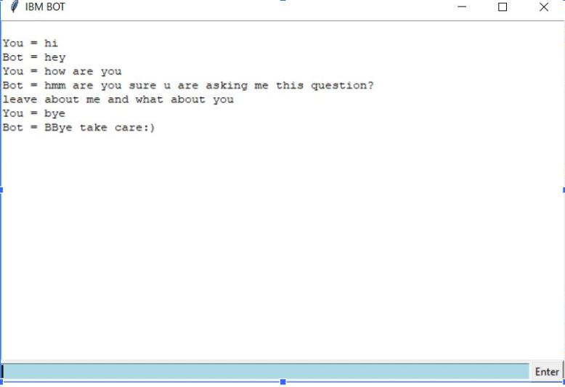
Output of the bot from user interface

